Slide 1

The 10 Most Common
Azure Mistakes
(and how to fix them)
scottsauber
Slides at scottsauber.com

Slide 2
Audience
Anyone using Azure
Technically some of these translate to AWS/GCP too

Slide 3
Agenda
Series of lightning talks
Account Organization
Naming Standards
Tagging Standards
Azure Policies
Managed Identities
DefaultAzureCredential
Requiring TLS 1.2+
Federated Credentials
Budgets and Cost Alerting
Reservations
Savings Plans
++ AI topics

Slide 4
Goals
Ideas on how to make your Azure more maintainable, cost effective, and more performant
At least one idea that you can go implement immediately at work

Slide 5





Who am I?
Director of Engineering at Lean TECHniques
Microsoft MVP
Dometrain Author
Redgate Community Ambassador
Co-organizer of Iowa .NET User Group

Slide 6

Why this talk?

Slide 7

Account Organization

Slide 8
Problem: Account Organization is a mess
Tip 1: Account Organization
One Subscription to rule them all
Subscriptions named by app sometimes and by team other times
Resource Groups with no real structure

Slide 9
Solution: Develop Account Organization Strategy
Tip 1: Account Organization
Subscriptions - It Depends™️
  Minimum: per environment boundaries
  Maximum: per team per environment boundaries
Resource Groups – always per app per environment
Service Groups – new as of May 2025
  Fancy tags
  Overlay to pull together across subscriptions, resource groups, etc – ie “Production apps” or “PCI Scope” or “MyApp”

Slide 10
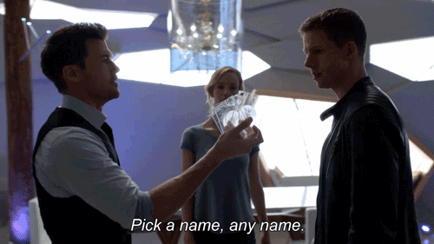
Naming Standards

Slide 11
Problem: Naming is a mess
Tip 2: Naming Standards
Naming has no consistency across apps, teams, divisions

Slide 12
Solution: Implement a Naming Standard
Tip 2: Naming Standards
Microsoft has a recommended naming convention based on recommended abbreviations
Example: app-navigator-dev-001 for an application called Navigator, that’s an App Service running in the Dev env
Azure has a naming tool you can run
AzureNamingTool
More important that you pick something and be consistent
Enforce with Azure Policy (more soon)

Slide 13

Tagging Standards

Slide 14
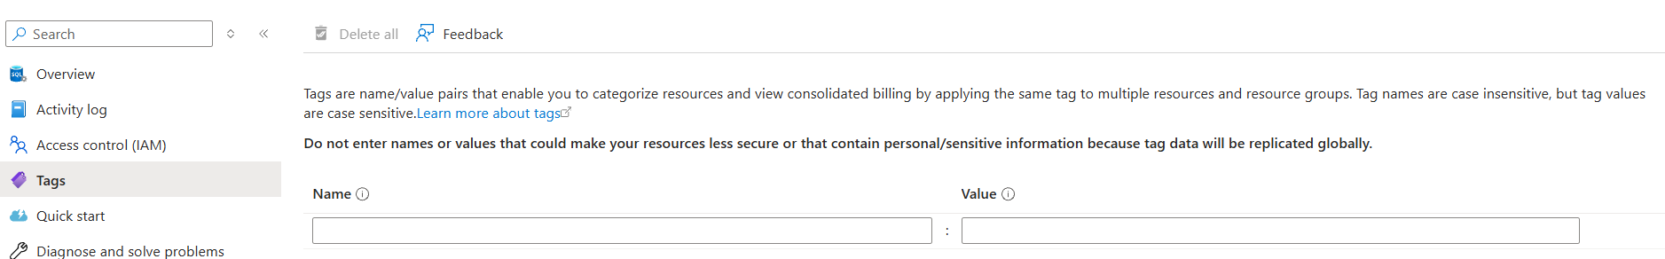
Problem: Tagging is a mess
Tip 3: Tagging Standards
Tags are metadata about the resource
No consistent tags
Makes it hard to answer questions like:
  How much does this app cost me a month?
  How much does the Dev environment cost me a month?`
  Who owns this resource?

Slide 15
Solution: Implement a Tagging Standard
Tip 3: Tagging Standards
Define a common set of Tags to be used on each resource
Common tags:
  Environment (Dev, Test, Production)
  Owner (so.andso@contoso.com)
  BusinessUnit (Finance, Sales, etc)
  Application (CRM, PaymentsPortal, etc)
  CostCenter (abc123, etc)
  ServiceClass (Tier1, Tier2, etc)
Enforce with Azure Policy (more soon)

Slide 16
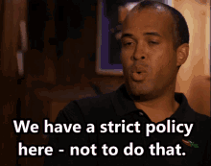
Azure Policies

Slide 17
Problem: We aren’t enforcing our standards
Tip 4: Azure Policies
You have a document defining standards
But it’s not followed

Slide 18
Solution: Azure Policies
Tip 4: Azure Policies
Azure Policies can enforce your naming standards
And your tagging standards
Can have multiple Policy Effects:
  Deny resources from being created - PREFERRED
  Audit - flag it as non-compliant
  Modify – auto change it – DON’T DO THIS
Can ensure resources are configured correctly too
  Ensure HTTPS enforcement
  SQL has Data Encryption at rest turned on

Slide 19

Managed Identities

Slide 20
Problem: We are managing credentials
Tip 5: Managed Identities
Credentials to manage – create, store, rotate, revoke
Azure SQL still using SQL Auth – username + password
Key Vault still using Client ID + Client Secret
Someone might accidentally commit a secret

Slide 21
Solution: Use Managed Identities
Tip 5: Managed Identities
Managed Identities allow you to give a resource an “identity” (user to run as essentially)
These Identities are managed completely by Azure – no username/password/client id/client secret needed
Assign a Managed Identity to an App Service/Function/etc
Give that Managed Identity access to read secrets, connect to a DB, etc
Completely passwordless
In your code you can use DefaultAzureCredential to do the right thing (more on this later)

Slide 22

DefaultAzureCredential

Slide 23
Problem: People use DefaultAzureCredential…
Tip 6: DefaultAzureCredentials
…without knowing the tradeoffs
DefaultAzureCredential is meant to get you into Azure as quickly as possible
The downside is – performance

Slide 24
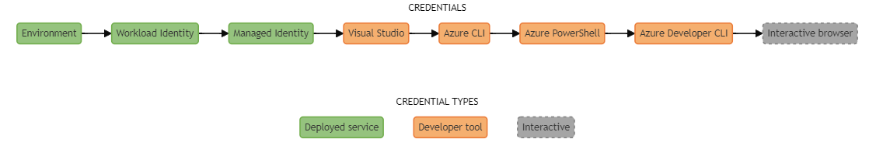
Problem: People use DefaultAzureCredential…
Tip 6: DefaultAzureCredentials

Slide 25
Solution: Be explicit about credentials
Tip 6: DefaultAzureCredentials
Locally – use AzureCli or VisualStudioCredential… else use ManagedIdentity
… or use Excludes on DefaultAzureCredential
This will save you ~2-10 seconds when interacting with the credential
DefaultAzureCredential Best Practices
My blog post on this in 2022

Slide 26
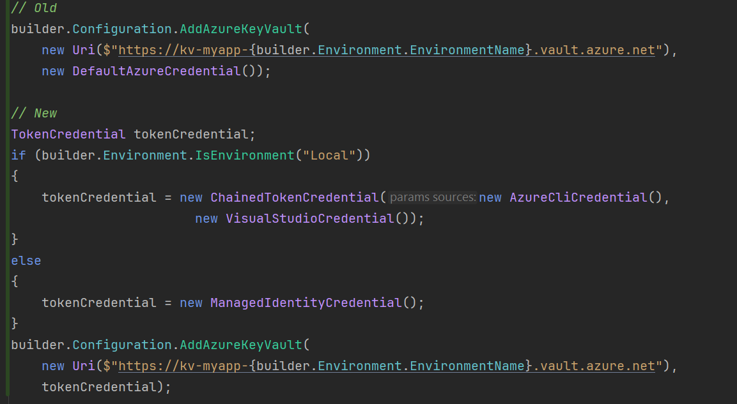
Solution: Be explicit about credentials
Tip 6: DefaultAzureCredentials

Slide 27

Requiring TLS 1.2+

Slide 28
Problem: Not requiring TLS 1.2+
Tip 7: Require TLS 1.2+
HTTPS has underlying encryption algorithms to encrypt your data in transit
These encryption algorithms have continually gotten better and better
Not requiring TLS 1.2+ allows users to connect to your app with insecure protocols
  Example – people on older browsers
This allows a man-in-the-middle attacks for people to decrypt in real time, exposing your data

Slide 29
Solution: Require TLS 1.2+
Tip 7: Require TLS 1.2+
Require TLS 1.2+ on all your relevant resources (ie app service, function apps, storage accounts, etc)
Make sure you also enforce a good cipher suite
  ie TLS_ECDHE_RSA_WITH_AES_128_GCM_SHA256 and TLS_ECDHE_RSA_WITH_AES_256_GCM_SHA384
TLS 1.3 is the latest, most browsers in the last 4-5 years support 1.3
SSL Labs to test your site - https://www.ssllabs.com/ssltest/

Slide 30

FederatedCredentials

Slide 31
Problem: Not using Federated Credentials
Tip 8: Federated Credentials
Your CI/CD pipelines need to auth to Azure to provision resources, deploy, etc
Without Federated Credentials, you’re managing a Client ID + Client Secret (most likely)
All the same issues managing credentials (create, store, rotate, revoke)
If someone gets these credentials, they can manipulate your Azure environment

Slide 32
Solution: Use Federated Credentials
Tip 8: Federated Credentials
Federated Credentials allows you to “trust” repositories to push to Azure
Passwordless
Short-lived tokens (minutes)
How to do this with GitHub Actions

Slide 33
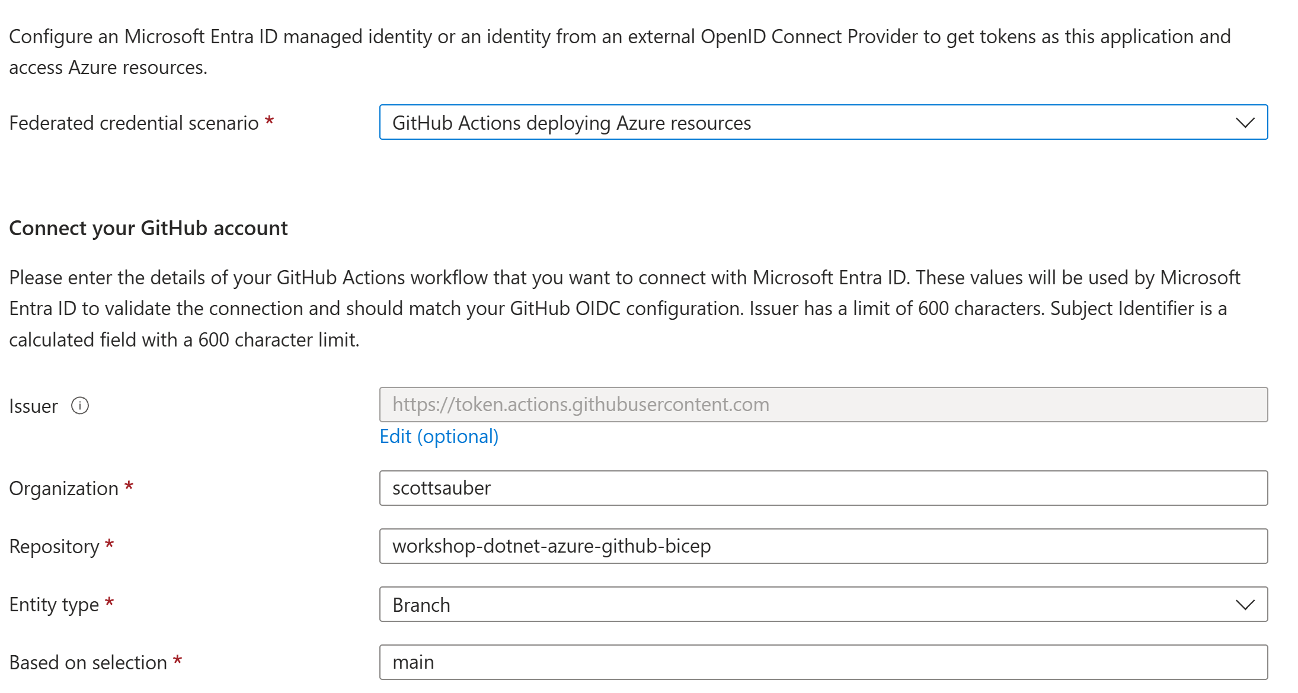
Solution: Use Federated Credentials
Tip 8: Federated Credentials

Slide 34

Budgets and
Cost Alerts

Slide 35
Problem: Cost isn’t managed in Azure
Tip 9: Budgets and Cost Alerts
Sudden, unexpected bills
No early warning for forecast overrun
Lack of visibility across teams
Missed anomalies and fraud detection

Slide 36
Solution: Use Azure Budgets
Tip 9: Budgets and Cost Alerts
Define a spending threshold for a scope (ie Subscription or Resource Group)
Tracks actual or forecasted against that target over a time period (monthly, quarterly, yearly)
Can have multiple thresholds, 50%, 80%, 100%
Can trigger Action Groups (email, Functions, Webhooks)
Budgets are a bad name – does not stop resources, only monitoring + triggers
Can lag by 24 hours

Slide 37
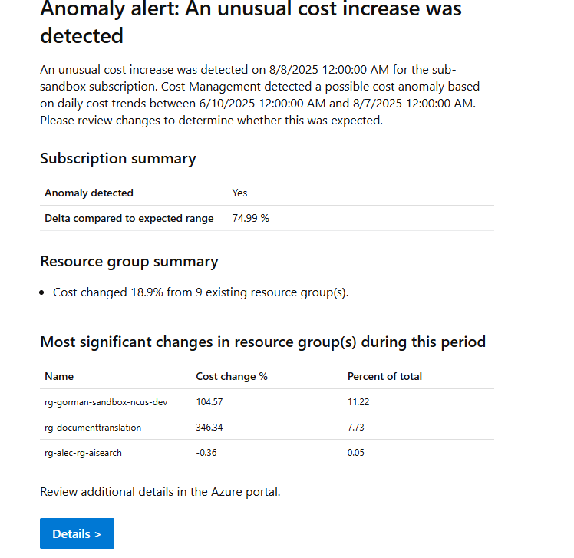
Solution: Use Azure Cost Alerts
Tip 9: Budgets and Cost Alerts
Anomaly Detection

Slide 38

Azure Reservations

Slide 39
Problem: Cost is getting too high
Tip 10a: Azure Reservations
Cloud isn’t always cheaper up front
Sometimes cloud is about speed, lower TCO, and more visibility

Slide 40
Solution: Azure Reservations
Tip 10a: Azure Reservations
Commit to using certain resources for 1 year or 3 years, get a discount between 20% - 70% depending on the resource (App Service Plans, SQL, VMs, Cosmos, etc)
Downside – what if you get rid of the resource after 2 years but you committed to 3
Still pay monthly or up front (if you want)

Slide 41

Azure Savings Plans

Slide 42
Problem: Cost is getting too high
Tip 10b: Savings Plans
Cloud isn’t always cheaper up front
Sometimes cloud is about speed, lower TCO, and visibility

Slide 43
Solution: Azure Savings Plans
Tip 10b: Savings Plans
Commit to using certain spend $ for 1 yr or 3 yrs, get a discount
Can be used however you want across eligible resource types

Slide 44
Comparing Savings Plans vs Reservations
Tip 10: Reservations && Savings Plans
Reservations give you more savings, but more risk if you need to change your plans
I recommend everyone use at least Savings Plans
Go tell your boss you can cut the Azure bill by at least 20% and get a promotion
Comparison of a single P0V3 App Service Plan:
 | Pay As You Go | Savings Plan | Reservation
1 year | 394.96 kr./mo | 269.76 kr./mo (32%) | 235.00 kr./mo (41%)
3 year | 394.96 kr./mo | 197.83 kr./mo (50%) | 162.69 kr./mo (59%)

Slide 45
AI Coding Agent
Tips for Azure

Slide 46
Problem: Need Azure Context
Tip 11: AI Coding Tips for Azure
Coding agents know about your codebase by default
They don’t know about Azure

Slide 47
Solution: az CLI
Tip 11: AI Coding Tips for Azure
Azure CLI already exists to get you access to everything in Azure
Install and then `az login`
Don’t even need to tell your agent to do this, just login and then it’ll self-discover that.

Slide 48
Problem: I have error logs, but manually review
Tip 11: AI Coding Tips for Azure
Error logs sitting in Log Analytics Workspace or App Insights
Maybe you’ve got alerting set up, maybe not
What if you could…

Slide 49
Problem: I have error logs, but manually review
Tip 11: AI Coding Tips for Azure
Error logs sitting in Log Analytics Workspace or App Insights
Maybe you’ve got alerting set up, maybe not
Requires a human to see that alert, review the error, and send the fix
What if…

Slide 50
A human sees the alert
A human reviews the error
A human sends the fix
Another human reviews the fix

Slide 51
An AI sees the alert
An AI reviews the error
An AI sends the fix
A human reviews the fix

Slide 52
Demo

Slide 53

Takeaways
Hopefully you got at least one idea today you can take back to work
This slide deck is your resource – up at scottsauber.com
scottsauber

Slide 54

Questions? ssauber@leantechniques.com
@scottsauber.com on Bluesky
@scottsauber on Twitter
/scottsauber on LinkedIn
Book free time with me:
Slides at scottsauber.com
scottsauber

Slide 55
Thanks!
Slides at scottsauber.com
scottsauber

